Slide 1

Understanding F&A Rates
OPTIONAL SUBHEAD HERE
Andrew McGehee
Minh Nguyen
November 4th, 2020

Slide 2


Why an F&A Cost Rate?
It is federal policy to provide for the reimbursement of F&A costs except when specific limitations and prohibitions exist
This is accomplished through use of an F&A rate
The cognizant agency negotiates and approves the F&A rates for an educational institution on behalf of all Federal agencies (2 CFR 200 App III C.11.a(1), OMB Circular A-21)
Understanding F&A Rates
Notes:
“F” stands for Facilities
“A” stands for Administrative
***
Write this down: “The regulations governing F&A are located in the Uniform Guidance 2 CFR 200, formerly known as OMB Circular A-21”.
As we work through the slides, we will see references to sections in the Uniform Guidance (UG) 2 CFR 200. To simplify, 2 CFR 200.414(c) will be shown as 200.414 (c) and 2 CFR 200 App III B.6.b(2) will be shown as App III B.6.B(2).

Slide 3
What is the F&A Cost Rate?
A single number that reimburses the institution for the use of:
  Buildings
  Equipment
  Interest on Debt for Buildings
  Operations & Maintenance
  General Administration
  Departmental Administration
  Sponsored Projects Administration
  Library
Understanding F&A Rates
Notes:
The facilities and administrative rate (F&A rate), frequently referred to as the indirect cost rate, is the federally-approved percentage applied to sponsored projects in order to recover the allowable overhead costs associated with conducting organized research.
The University pays these costs upfront, such as when equipment is purchased, then as grants use these items the grant reimburses the University for the use.
***
We will go over these items in detail in slides 16 through 27.

Slide 4
. . . or stated another way . . .
The ratio, expressed as a percentage, of an OR facilities and administrative cost pool and an OR direct cost base.
The OR cost pool is made up of allocations from the administrative and facilities cost pools
OR allocated pool costs/OR base direct costs = OR F&A rate.
Understanding F&A Rates
Notes:
The rate is just a fraction of items that the University has paid for in advance that support grant work divided by the dollars spent on a grant.
OR is Organized (externally sponsored) Research.

Slide 5
Calculation of the Facilities & Administrative Cost Rate (aka = Indirect Cost Rate)
F&A COSTS
Building Depreciation
Equipment Depreciation
Interest on Debt
Operations & Maintenance
Library Support
General Administration
Departmental Administration
Sponsored Project Administration
DIRECT COSTS
Research Salaries & Fringes
Consultant Services
Travel
Technical Services
Research Supplies
Subcontracts up to $25,000
Committed Cost Sharing
$70,110,000
F&A Costs ÷ Direct Costs
$114,000,000
0.615 = 61.5%
Understanding F&A Rates
Notes:
The “F” (Facilities costs) are blue and the “A” (Administrative) are orange.
F&A is also known as indirect or overhead costs.
The column on the right contains some of the types of costs (direct spending on grants) that go into the base.
We divide the costs associated with research by the research base to get the F&A rate which is a fraction that’s expressed as a percent.
>>Click to show the numbers.
These amounts are approximately what we ended up with after our last negotiation using FY2014 base year.

Slide 6
Types of F&A Rates
Negotiated lump sum for F&A App III C.3
Predetermined rates - normally for 2-4 years App III C.4
Fixed rates and carry forward provisions App III C.5
Provisional and final rates App III C.6
Simplified Method for Small Institutions (<$10 million total direct cost in a year) App III D
Understanding F&A Rates
Notes:
Negotiated Lump Sum is a negotiated fixed amount in lieu of indirect costs. The lump sum is offset against the pools before allocation to the 4 bases.
Predetermined rates apply to a specific time period (usually the institution’s fiscal year) and may be negotiated for periods of 2 to 4 years. Generally, predetermined rates cannot be adjusted.
Fixed rates are negotiated in advance of a period, such as a fiscal year. The over/under recoveries may be used to adjust the indirect costs for the next rate negotiation.
When the federal government determines that cost experience or other pertinent facts do not justify the use of predetermined rates, or a fixed rate with a carry-forward, or the government and the institution cannot agree on an equitable rate, a provisional rate must be established.
If a fiscal year ends while still using a provisional rate, a final rate will be established, with adjustments based on the actual allowable costs incurred for the period involved.
Simplified Method for Small Institutions may use MTDC or Salaries and Wages. GA, O&M, Library, DA = 20% of deans and department heads salaries and expenses divided by base.

Slide 7
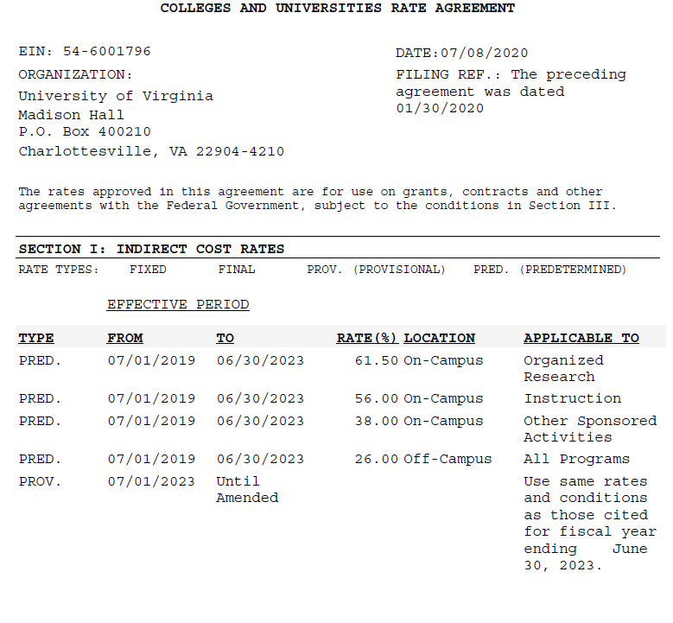
Current UVa F&A Rate Letter
Understanding F&A Rates
Notes:
Our current F&A rate agreement letter, dated 07/08/2020, is based on our FY14 costs and established predetermined rates through 6/30/2023 for UVa. Our OR rate is 61.5%.

Slide 8
F&A Rate Extension Requests
UVA was granted a four year extension of the current rates in FY2020
One year extension (of rates and base) due to COVID-19
FY2022 will be next base year
Understanding F&A Rates

Slide 9
Commonly Used Acronyms
F&A – Facilities and Administrative = Indirect Costs
MTDC – Modified Total Direct Cost
MTC – Modified Total Cost
TDC – Total Direct Cost
S&W – Salaries and Wages
FTE – Full Time Equivalent
GA - General Admin and General Expenses
SPA – Sponsored Projects Administration
DA – Departmental Administration
OIA – Other Institutional Activities
OSA – Other Sponsored Activities
OR – Organized Research
O&M - Operations and Maintenance
IHE - Institutions of Higher Education
Understanding F&A Rates
Notes:
List of acronyms we discuss today
***
GA is for University-wide functions only. The President’s Office, Executive VP & Chief Operating Officer’s units, the General Counsel’s office, HR, and the VP-Finance which includes Procurement are examples of GA.
DA is Departmental Administration which is the operation of the Deans’ offices in each school, such as SOM, A&S, SEAS, and Curry. The Deans operations are not GA.
Departmental Administration doesn’t include most of the costs for operating the individual Academic departments (including dept chairs), such as Biology, Chemistry, Pediatrics, Surgery, or the SOM Internal Medicine group.
O&M includes Facilities Management, the University Police, the Office of Emergency Preparedness, and the Office of the University Architect. O&M is all the costs for operating, maintaining, protecting, and improving our buildings and grounds.
The use of these acronyms follow federal costing guidance set forth in Title 2 Code of Federal Regulations, Part 200.

Slide 10
The Direct Cost Bases
Understanding F&A Rates

Slide 11
The Direct Cost Bases
Bases represent an institution’s direct costs activities App III A.1:
  Instruction and departmental research (IDR)
    Sponsored instruction and training
    Departmental research
  Organized research (OR)
    Research Training
    Sponsored research
    University research
  Other sponsored activities (OSA)
  Other institutional activities (OIA)
Understanding F&A Rates
Notes:
There are four bases that represent the major functions of the University.
They are Instruction, which includes sponsored instruction in the rare instances that we have any, Organized Research, OSA, which is sponsored programs that are not SI or OR, and OIA.
Instruction includes Sponsored instruction/training and Departmental research. Departmental research is research that is paid for by departmental money. Generally, the funds are not won through a bidding process comparable to sponsored grants, do not require rigorous reporting on progress and expenditures, nor publication of results. Often these funds provide bridge, gap, interim, or start-up support for a PI. DR is research is usually funded by F&A recoveries or other departmental funds, such as gift money.
OR has three components: SR (sponsored research) and RT (research training), and UR (university research). UR is internally-funded projects that must be applied for in a manner similar to externally-sponsored projects, there also is usually a reporting requirement.
Cost sharing is also part of the OR base because the federal guidance directs us to add cost share to the denominator.
Remember that the F&A rate is a fraction. The base is the bottom part of the fraction. When the denominator increases, the rate goes down.
Not only does cost share lower our F&A rate for all grants, but we provide cost share free of charge to the grant and we can’t collect F&A on cost share.
This is part of why we don’t like cost sharing – it decreases our F&A rate.
OSA is Other Sponsored Activities and includes all sponsored work that is not classified as sponsored instruction or organized research. These projects are typically conducted by non-science departments (History, Batten School, Architecture, Darden, Law, the Diversity Office, foreign languages, etc.) and do not require usage of specialized lab spaces or heavier utilities.
OIA is Other Institutional Activities which includes non-sponsored community service, fundraising, lobbying, public relations, and auxiliaries.
***
Write these down:
App III A.1.a(2) “Departmental research means research, development and scholarly activities that are not organized research and, consequently, are not separately budgeted and accounted for.”
App III A.1.b(2) “University research means all research and development activities that are separately budgeted and accounted for by the institution under an internal application of institutional funds.”
App III A.1.d OIA includes residence halls, dining halls, student unions, intercollegiate athletics, bookstores, chapels, public museums, and other similar auxiliary enterprises. OIA also includes the costs which are unallowable to sponsored agreements.
The bases are broadly defined by 2 CFR 200, Appendix III (formerly OMB Circular A-21) and specifically defined as submitted in our F&A Rate Proposal.

Slide 12
The Direct Cost Bases
App III C.2 discusses the distribution basis for F&A costs and defines it as modified total direct costs (MTDC).
MTDC usually includes
  Salaries and wages & associated fringe benefits
  Materials and supplies
  Services
  Travel
  Sub-grants and subcontracts up to the first $25,000
Understanding F&A Rates
Notes:
For Subcontracts UVa grants to another entity, such as a university or research institute, F&A is charged on only the first $25,000 for the ENTIRE period of the subcontract.
For example: a $1M multi-year subcontract, F&A is charged only on the first $25,000. No F&A is charged on the remaining $975,000 direct costs of the subcontract.
If UVa is subcontracted to do work on a grant owned by another university, F&A will be charged on all MTDC costs.

Slide 13
The Direct Cost Bases
MTDC excludes 200.68
  Sub-grant and subcontract costs over $25,000
  Equipment (capital equipment only)
  Capital (buildings/renovations) expenditures
  Patient care
  Tuition remission
  Scholarships and fellowships
  Space rental costs
  Participant support costs 200.75
Understanding F&A Rates
Notes:
F&A cannot be recovered from expenditures that are for exclusions.
In my mind I compress this to 6 categories: subcontracts >$25K, capital expenditures (equipment and capital), patient care, student aid (tuition remission and scholarships/fellowships), rent, and participant support costs (student and non-employee participants).

Slide 14
The Direct Cost Bases
Issues to consider
  Unallowable costs 200.405(b)
  Cost overruns (CAS 9905.505)
  Cost share or matching (CAS 9905.502)
  Salaries over the NIH cap (NOT-CO-16-059)
  Research Training Grants App III A.1.b(1)
  Applicable Credits 200.406
  Bases other than MTDC
Understanding F&A Rates
Notes:
Unallowable costs are not the same as exclusions.
F&A is not charged on unallowable costs, but must be included in the base for calculating the rate.
Unallowable costs related to research go into the OR base. Unallowable costs related to OSA go into the OSA base. All other unallowable costs go into OIA.
Cost overruns are unallowable costs and therefore must be added to the base.
Cost sharing must be added to the base.
Every year since 1990, Congress has legislatively mandated a provision capping the direct salary that an individual may receive under an NIH grant.
In essence, salaries over the NIH cap are unallowable and must be added to the base. Release Date: 01/05/2020 $197,300.00
Remember the F&A rate is a fraction so when the denominator gets larger, the rate gets smaller.

Slide 15
Indirect Costs
Understanding F&A Rates
Notes:
We group costs in indirect pools because it would be a huge burden to track every square foot of a research lab or every sheet of a pad of paper to map directly to Instruction vs. OR vs. OSA vs. OIA.

Slide 16
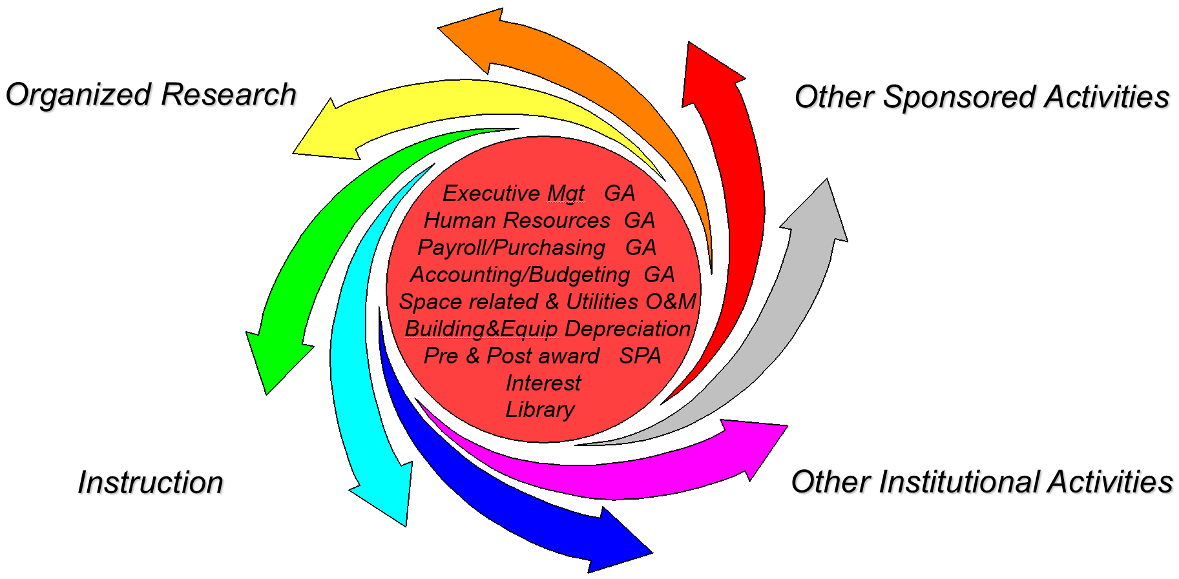
Facilities & Administrative Costs
Costs that are incurred for common or joint objectives and therefore cannot be identified readily and specifically with a particular sponsored project, instructional activity, or any other institutional activity. 200.414 and App III A
Understanding F&A Rates
Notes:
Write this down: App III B.6.b(2) “Items such as office supplies, postage, local telephone costs, and memberships shall normally be treated as F&A costs”.
In general, these should not be charged directly to a grant. Such costs generally should be paid with University funds, including F&A monies.
The Facilities and Administrative Rate (F&A Rate) is the mechanism used to reimburse the University for the infrastructure support costs associated with sponsored research and other sponsored projects. The F&A rate is essentially an overhead rate. It is calculated as a percentage of overhead associated with, an allocable to, sponsored research and other activities, divided by the direct costs of sponsored research and other activities. To collect F&A, the University adds the negotiated F&A rate to invoices or other billing instruments submitted to sponsors

Slide 17
The Facilities Components
Building depreciation
Equipment depreciation
Interest expense
Operations and maintenance
Library
Understanding F&A Rates
Notes:
These are the “F” cost pools.
***
The term “pool” just means a group of costs, often, but not always, “pool” is used to refer to the F&A (indirect) groups of cost and “base” is used for the direct groups, but NOT consistently.

Slide 18
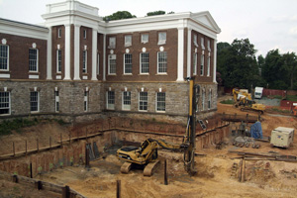
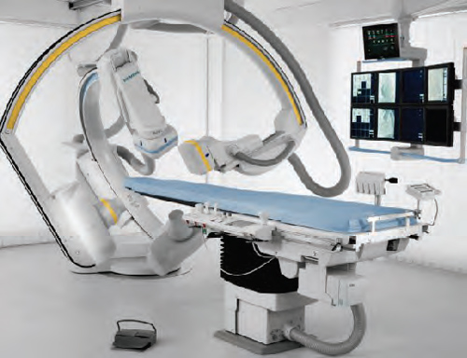
Depreciation and Use Allowance
Expenses are for the portion of costs related to the institution’s buildings, capital improvements to land and buildings, and equipment which are computed in accordance with 200.436, see also App III B.2.
Understanding F&A Rates
Notes:
Building depreciation – we build research buildings, they are used for doing research, the federal sponsor will reimburse us for that use. We depreciate capital assets to spread the cost over a number of years rather than incurring it all at once in one year.
Major renovations that are above the $250K threshold are also capitalized. The renovation of research space is included in the research calculation.
Similar to building depreciation, we depreciate capital equipment (the threshold is $5K). We decide how much equipment depreciation is for research use from the room it is located in. That’s why an accurate equipment inventory is so important.
For example, in our 2007 F&A rate submission we had to lower the rate that we had submitted because the location of the Da Vinci robot was mis-reported in the equipment inventory.

Slide 19
Interest on Debt
Interest associated with certain buildings, equipment, and capital improvements are allowable if they support sponsored agreements 200.449 and App III B.3
  Buildings acquired or completed after July 1, 1982
  Major reconstruction and remodeling of existing buildings completed on or after July 1, 1982
  Acquisition or fabrication of capital equipment on or after July 1, 1982, costing $10,000 or more, if the government agrees
Understanding F&A Rates
Notes:
This is interest that we pay on bonds issued for construction.
The interest on research buildings is part of the research rate calculation.
We can also include the state interest paid for UVA buildings that is recorded in the “Statewide Indirect Cost Allocation Plan” (SICAP) by the Virginia Department of Accounts.

Slide 20
Operations & Maintenance
Expenses incurred for administration, supervision, operations, maintenance, preservation, and protection of the institution’s physical plant 200.452 and App III B.4.
Normally includes:
  Janitorial/housekeeping
  Utilities
  Grounds maintenance
  Safety and risk management
  Police and Security
  Environmental safety
  Hazardous materials disposal
Understanding F&A Rates
Notes:
O&M is more than just Facilities Management performing custodial duties and regular on-going maintenance. O&M includes Police, Security, and Environmental Health and Safety.

Slide 21

Library
Expenses incurred for the operation of the library, including the costs of books and library materials purchased for the library, less applicable credits App III B.8
Standard Allocation based on FTEs
Understanding F&A Rates
Notes:
Rather than create a third category of indirect costs, the libraries are also considered an “F” component.

Slide 22
The Administrative Components
Administrative components (cost pools)
  General administration and general expenses
  Departmental administration
  Sponsored projects administration
  Student administration and services
The combined total of Administrative components is capped at 26% of modified total direct costs App III C.8
Understanding F&A Rates
Notes:
The important point here is that Admin is capped at 26%. That means no matter how much we determine that the University incurs for admin expense, we will only get a maximum of 26% in our F&A rate.
For instance, we submitted 35.8% for Admin in our FY14 F&A proposal and, by regulation, we got 26%.

Slide 23
General Administration and General Expenses
Expenses incurred for the general executive and administrative office and other expenses of a general nature which do not relate solely to any major function of the institution App III B.5
Normally includes
  Allocations from administrative offices that serve an entire university system, (e.g. California, North Carolina, Texas)
  Institutional administrative executive offices
  Financial planning, budgeting, payroll, accounting
  General Counsel
  Management information systems
  Cross allocations from depreciation, interest, and O&M cost pools
  Admin costs from the SICAP 200.418
Understanding F&A Rates
Notes:
After we include the state interest paid for our buildings that is recorded in the “Statewide Indirect Cost Allocation Plan”, the remaining SICAP costs attributable to UVA are included in General Administration.
***
You may see the term SWICAP which is just another acronym for SICAP.

Slide 24
Departmental Administration (DA)
Expenses incurred for administrative and supporting services that benefit common or joint departmental activities or objectives App III B.6
DA costs are not normally identified on university current financial statements
Cross allocations from depreciation, interest, O&M, and GA cost pools
Understanding F&A Rates
Notes:
These costs are incurred for administrative and supporting services in departments, interdepartmental laboratories, or centers, and provide a benefit to the research projects in these units. This category includes the salaries and wages costs for Department Heads and Institute Professors, Academic Deans and Laboratory Directors and Deans. Office expenses and other costs related to the administration of the entire department, including the academic department headquarters, also fall under departmental administration.

Slide 25
Departmental Administration
Composed of:
Academic deans’ offices (limited to costs associated with administrative activities) App III B.6.a(1)
Academic department and division salaries and fringe benefits attributable to administrative work
  Includes bid and proposal effort
  Limited to 3.6% of department MTDC of faculty and professional personnel conducting research and/or instruction App III B.6.a(2)(a)
  3.6% limit does not apply to professional business or administrative officers
  Other administrative and supporting costs are allowable provided they are treated consistently in like circumstances (includes secretarial and clerical salaries, administrative officers and assistants, travel, office supplies, etc.) App III B.6.a(2)(b)
Understanding F&A Rates
Notes:
***
In general, most grants should not directly pay for office supplies, postage, local telephones, and memberships. Only rarely should grants directly pay for administrative support.
Remember I said when we were on slide 16, App III B.6.b(2) is where you will find, “Items such as office supplies, postage, local telephone costs, and memberships shall normally be treated as F&A costs.”
If the grant work is to perform a mail or telephone survey, then office supplies, postage, local telephone costs could be charged directly to the grant.

Slide 26
Sponsored Projects Administration
Expenses are limited to those incurred by a separate organization established primarily to administer sponsor projects. Includes grant and contract administration, special security, purchasing, personnel, etc. App III B.7
Cross allocation from depreciation, interest, O&M, and GA cost pools
SPA is allocated to the functions performing sponsored projects based on MTC of the sponsored projects
  Usually includes
    Organized research
    Sponsored instruction
    Other sponsored activity
Understanding F&A Rates
Notes:
Sponsored Projects Administration (SPA) includes OSP and the SOM and Engineering research administration groups which report to OSP as a dotted line on the University org chart. The SOM and Engineering groups are dedicated departments with their own budgets.
Research administration conducted in the other colleges are not SPA.

Slide 27
Student Administration and Services
Expenses incurred for the administration of student affairs and for services to students, including deans of students, admissions, registrar, counseling and placement, student advisors, student health and infirmary services, catalogs, commencements, and convocations App III B.9
Cross allocation from depreciation, interest, O&M, and GA cost pools
Student Administration and Services shall normally be allocated 100 percent to instruction function App III B.9.b
Understanding F&A Rates
Notes:
All support for students is allocated to Instruction.

Slide 28
What is a Space Survey?
The space survey is the process of assigning institutional space into 2 CFR 200 functional categories based on space use App III A.2.d(3)
The results are used to calculate the percentage of space that is used to support organized research and support the subsequent allocation of space related costs to organized research
Used to allocate Building and Equipment Depreciation, Interest, and O&M, i.e. all the “F” components, except Library
Understanding F&A Rates
Notes:
The space survey is the most important activity that goes into the F&A proposal because most of the allocations are driven by the functional percentage of space. The federal reviewers know how important space is and will review the space survey results to determine whether we have skewed the results to inflate the recovery rate we submit.

Slide 29
The F&A Rate Calculation Process
Audited Financial Statements
MTDC Exclusions:
Capital Expenses
Subcontracts >$25k
Scholarships/Fellowships
Patient Care Costs
Tuition Expenses
Rental Costs
Participant Support Costs
Other Exclusions:
Cost of Goods Sold
Total Costs
Adjustments & transfers
F&A Costs Pools:
Depreciation
Operations & Maintenance
General Administration
Departmental Administration
Sponsored Program Admin.
Library
Student Admin. & Services
Review for Unallowable Expenses
Applicable Credits
Direct Cost Bases:
Instruction and Dept. Research
Organized Research
Other Sponsored Activities
Other Institutional Activities
Other Special Direct Bases
Assign Expenses to F&A Pools and Direct Bases
Allocations
F&A Costs | Major Functions | Distribution Base
X | Instruction & Department Research | XX
X | Organizes Research | XX
X | Other Sponsored Activities | XX
X | Other Institutional Activities | XX
Understanding F&A Rates
Notes:
We start with the downloaded total costs from the audited financial statements.
We remove the costs for exclusions which leaves us with MTDC costs.
For MTDC costs, we make adjustments and transfers, such as for unallowable expenses and applicable credits.
Next, we assign expenses to pools and bases.
Using various statistics, we allocate the pools to the bases.

Slide 30
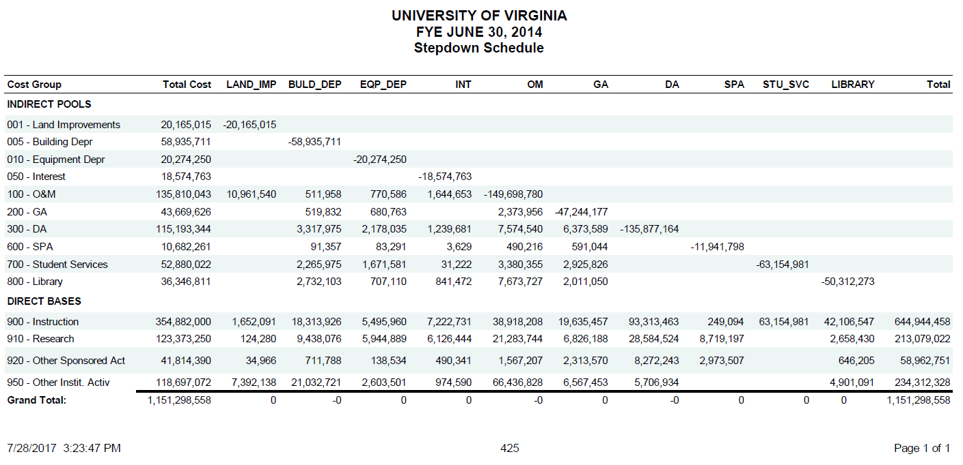
Actual Cost Allocations
Understanding F&A Rates
Notes:
This is the actual allocation of all costs from our last F&A Proposal

Slide 31
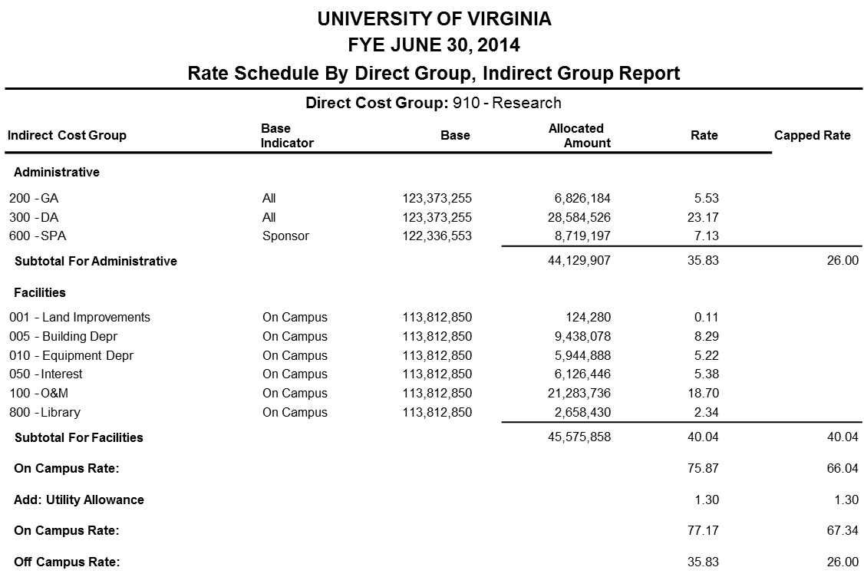
Actual Rate Components
Understanding F&A Rates
Notes:
This is the actual allocation of all costs from our last F&A Proposal

Slide 32
Other F&A Rate Proposal Issues
The proposal and supporting documentation becomes the basis for negotiating the institution’s F&A rate
Standard format required by App III C.12
Certifications by VP or CFO required by App III F.1 & 2
Base period normally coincides with fiscal year App III B.1.e
Cost analysis study for allocation App III A.2.d(3)
Negotiated rates in effect at the time of the initial award shall be used through the life of the sponsored agreement App III C.7
Disclosure Statement if aggregate >$25Million 200.419
Understanding F&A Rates
Notes:
Per Federal Public Law 100-679, the federal government requires institutions of higher education that receive more than $25 million in federal research contracts or grants to disclose their cost accounting practices for measuring, assigning, and allocating costs in disclosure statement DS-2. The disclosure statement clarifies the cost accounting practices that the institution follows, or proposes to follow, and provides the federal government with more fiscal controls to ensure greater efficiency, effectiveness, and accountability by institutions receiving federal grants or contracts.

Slide 33
When/Where to Submit the Proposal?
The proposal is submitted to either the Department of Health and Human Services (DHHS), Cost Allocation Services (CAS) for DHHS cognizant schools or to the Office of Naval Research (ONR) for the Department of Defense (DOD) cognizant schools App III C.11
CAS-DHHS
  DCA Best Practices Manual for Reviewing Institutions of Higher Education Long-Form Facilities & Administrative Cost Rate Proposals
  https://rates.psc.gov/fms/dca/Updated%202017%20CU%20Best%20Practices%20Manual.pdf
Office of Naval Research
  Reviews conducted by Defense Contract Audit Agency (DCAA)
Usually due 6 months after the end of the base year.
Understanding F&A Rates

Slide 34
Applying the F&A Rate – Problem 1
F&A Rate = 40%
Research project budget for direct costs = $125,000
Item of equipment included in direct costs = $25,000 (only item excluded from the F&A base)
What is total cost of the project?
MTDC = Total direct costs - exclusions
MTDC = $125,000 - $25,000 = $100,000
F&A = MTDC x F&A rate
F&A = $100,000 x 40% = $40,000
Total cost = Total direct costs + F&A costs
Total cost = $125,000 + $40,000 = $165,000
Understanding F&A Rates
Notes:
There were FIVE F&A calculation questions on the CRA exam in December 2009.
Since a ton of information is given in a problem, its sometimes easier to drop down and read the question, then look at the facts. Here they are asking for the total cost of the project.
In this example, you need to determine the amount of MTDC so you can calculate the amount of F&A.
Then, add the total direct costs and the F&A.

Slide 35
Applying the F&A Rate – Problem 2
F&A Rate = 61.5%
Research project budget for direct costs = $250,000
Subcontract costs = $75,000
What is total cost of the project?
MTDC = Total direct costs - exclusions
MTDC = $250,000 - exclusions
MTDC = $250,000 - ($75,000 - $25,000)
MTDC = $250,000 - $50,000 = $200,000
F&A = MTDC x F&A rate
F&A = $200,000 x 61.5%=$123,000
Total cost = Total direct costs + F&A costs
Total cost = $250,000 + $123,000 = $373,000
Understanding F&A Rates
Notes:
Here’s a similar problem, but using subcontract costs.
What are the exclusions? Equipment, Subcontract costs > $25,000, Patient care, Tuition Remission, Scholarships/Fellowships, Renting space.
Why is it trickier with subcontract costs? There is F&A on the first $25,000, but not on the rest.
Add the total direct costs and the F&A.

Slide 36
Applying the F&A Rate – Problem 3
PI on NSF grant to re-budget $150,000 in renovation monies into equipment
F&A rate = 61.5%
How much is available for equipment purchase?
Total available = total direct + total F&A
Total available = (MTDC + exclusions) + (MTDC x F&A rate)
$150,000 = (0 + equipment) + (0 x 61.5%)
$150,000 = equipment + 0
Equipment = $150,000
Understanding F&A Rates
Notes:
Read the question first. They aren’t asking for total costs. They are looking for the amount available for equipment purchase.
Remember from slide 18 that we depreciate capital assets to spread the cost over a number of years rather than incurring it all at once in one year.
Equipment costing more than $5,000 is capital equipment.
There is no F&A charged on capital equipment.
Therefore, the entire $150,000 is available for equipment purchase.

Slide 37
Applying the F&A Rate – Problem 4
PI on NSF grant to re-budget $150,000 in renovation monies into personnel costs
F&A rate = 50%
How much is available for personnel costs?
Total available = total direct + total F&A
Total available = (MTDC + exclusions) + total F&A
Total available = (MTDC + exclusions) + (MTDC x F&A rate)
$150,000 = (personnel + 0 ) + (personnel x 50%)
$150,000 = (personnel x 1) + (personnel x 0.50)
$150,000 = personnel x (1 + 0.50)
Personnel = $150,000 / 1.50
Personnel = $100,000
Understanding F&A Rates
Notes:
Personnel costs are Salaries/Wages/Fringe Benefits.
F&A is charged on personnel costs.
Therefore, the amount left for personnel costs is the total amount less the F&A.
(F&A = $50,000 = $100,000 * .50)

Slide 38
Applying the F&A Rate – Problem 5
Total grant available = $800,000
F&A rate = 54%
Tuition remission = $5,000; Subcontracts = $29,000; one piece of equipment = $21,000
How much is available for direct costs?
Total available = total direct + total F&A
Total available = (MTDC + exclusions) + (MTDC x F&A rate)
$800,000 = (MTDC +$5000+$4000+$21,000)+(MTDC x 54%)
$800,000-$30,000 = (MTDC x 1) + (MTDC x 0.54)
$770,000 = MTDC x (1 + 0.54)
MTDC = $770,000 / 1.54 = $500,000
Total directs = MTDC + exclusions
Total directs = $500,000 + 30,000 = $530,000
Understanding F&A Rates
Notes:
The trick here is to remember that for subcontracts only the amount above $25,000 is excluded, so $29,000 - $25,000 = $4,000 excluded.
Also, pay attention to what they are asking for: Total Directs, not MTDC.
(F&A = $270,000 = .54 * $500,000)

Slide 39
Significant Issues Regarding Recharge Operations
Understanding F&A Rates

Slide 40
Recharge Operations
“Where it is determined that certain expenses are for the support of a service unit or facility whose output is susceptible of measurement on a workload or other quantitative basis, such expenses should be set aside as a separate cost grouping for distribution on such basis to organized research, instructional and other activities at the institution or within the department.” App III A.2.c(3)
“If directly related to a specific award . . . The cost of materials supplied from stock or services rendered by specialized facilities or other institutional service operations” . [may be included as direct costs to sponsored agreements] 200.413(b)
Understanding F&A Rates
Notes:
Regulations allow recharge centers to charge federal grants.

Slide 41
2 CFR 200 App III B.6.b(1)
“costs incurred for the same purpose in like circumstances are treated consistently as either direct or F&A costs. For example, salaries of technical staff, laboratory supplies . . . shall be treated as direct costs whenever identifiable to a particular cost objective. Direct charging of these costs may be accomplished through specific identification of individual costs to benefiting cost objectives, or through recharge centers or specialized service facilities, as appropriate under the circumstances.”
Understanding F&A Rates

Slide 42
2 CFR 200.468
“Does not discriminate against federal-supported activities of the institution, including usage by the institution for internal purposes.”
“Is designed to recover only the aggregate costs of the services.”
“The costs of the service shall consist normally of both its direct costs and its allocable share of all F&A costs.”
Rates shall be adjusted at least biennially, and shall take into consideration over/under applied costs of the pervious period(s).
Understanding F&A Rates
Notes:
No one can pay less than what federally-supported activities pay.
The rates that recharge centers charge are based on actual costs for producing the goods or services.
The center cannot make a profit (accumulate a surplus) although they can charge depreciation to build up a reserve for purchasing replacement equipment.
The charges can be burdened with F&A.
Rates are reviewed and updated to incorporate operating surpluses or deficits into the new rate.

Slide 43
Other Recharge Center Key Points
No profit – break-even operations - recover only cost
No unallowable costs
If over-charge, then must refund to every grant or lower next year’s rate
Depreciation is allowable
Consistency, consistency, consistency
Use a recognized method of computing actual costs
Confirm to generally accepted cost accounting practices
Service center, recharge center, specialized service facility
Understanding F&A Rates
Notes:
Other key points in what a recharge or service center can include in the rates that they charge their customers.

Slide 44
Questions?
  Office of Financial Planning & Analysis contact information
  Andrew McGehee ajm9ws@virginia.edu
  Minh Nguyen mtn9ba@virginia.edu
  Our F&A website is at
  https://financialplanning.vpfinance.virginia.edu/facilities-administrative-costs
Understanding F&A Rates

